Slide 1
Fall ‘15 Spring ‘16 Control group SN’s
Draft 1 02/16/2017
Created by Neil Yetz

Slide 2
This document contains:
Social Networks for the Control Nights of CC for Fall ’15 and Spring ‘16
F15 control = Mon/Wed
S16 control = Tue/Wed
There are 5 SN’s in each slide showing the change in the program SN at 5 survey points (Week: 1,3,6,9,11)
Also noted are each Networks: Centrality (Cen), Density (Den), & Reciprocity(Rec), and Network Size (N)
RED TEXT indicates unexpected trends in the SN
Need to think of ways to clean the data

Slide 3
FALL 15

Slide 4
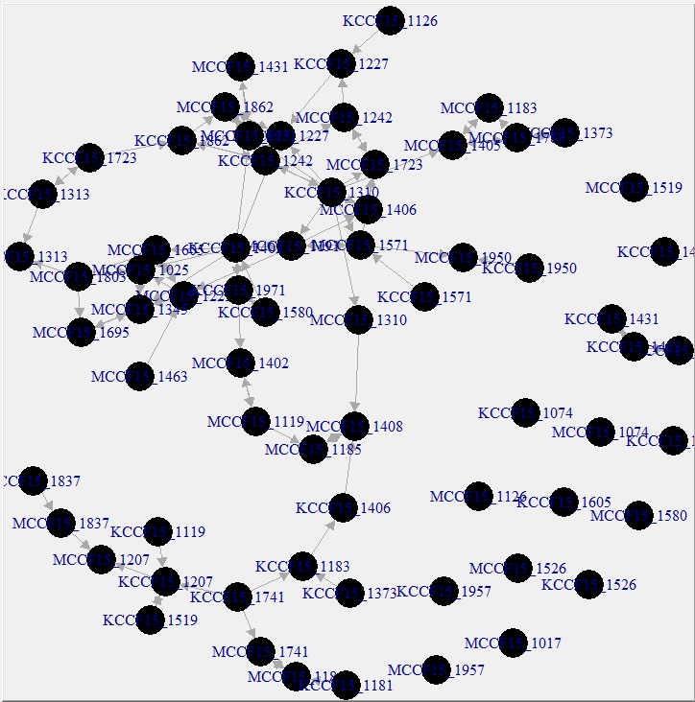
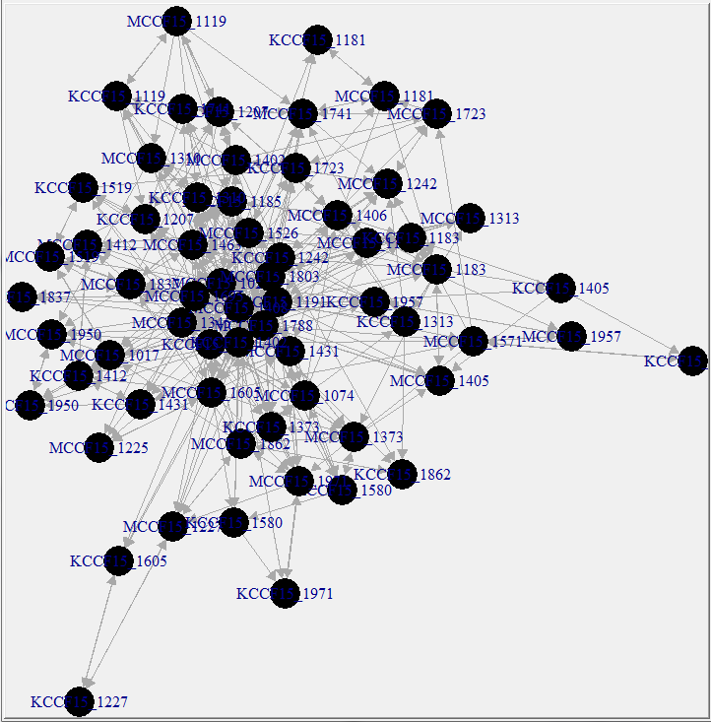
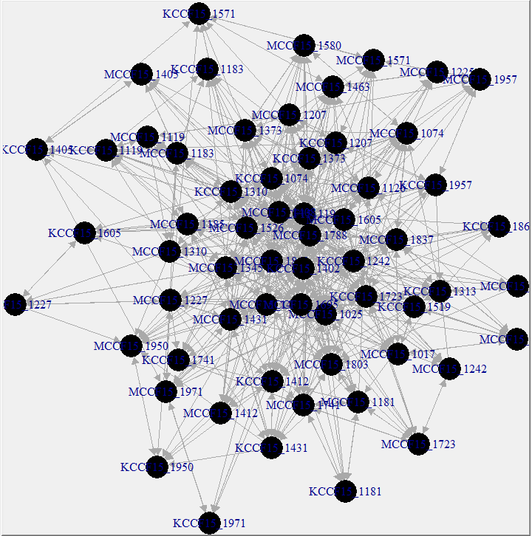
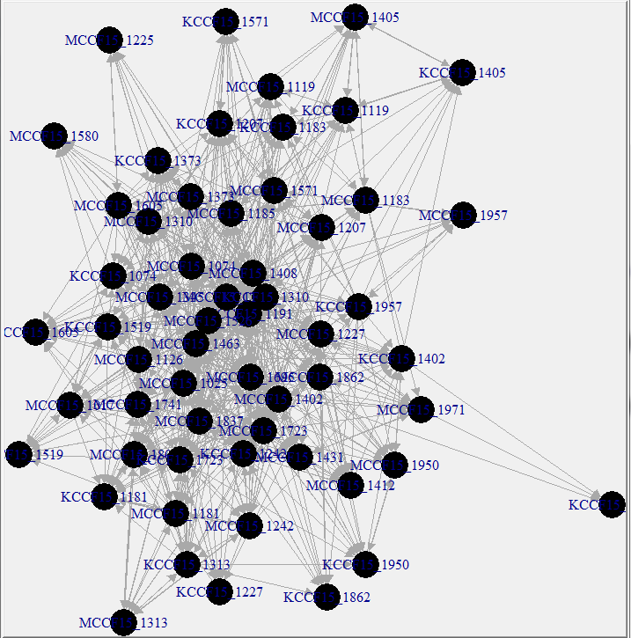
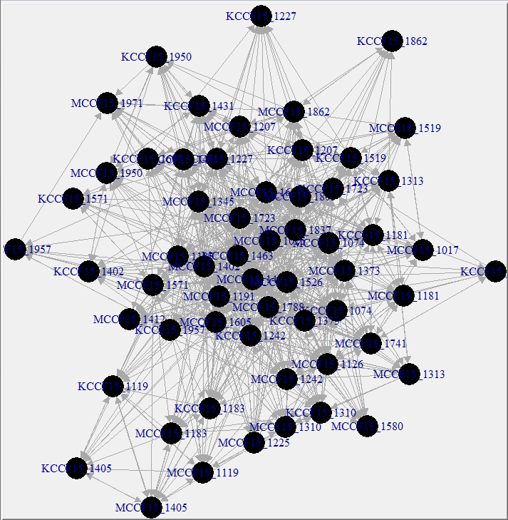
Fall ’15 MONDAY control
Week 1
Week 3
Week 6
Week 9
Den: 0.02
Cen: 0.05
Rec: 0.43
N= 68
Den: 0.11
Cen: 0.16
Rec: 0.44
N = 64
Den: 0.18
Cen: 0.17
Rec: 0.50
N=61
Den: 0.23
Cen: 0.17
Rec: 0.47
N = 58
Week 11
Den: 0.25
Cen: 0.20
Rec: 0.49
N=59

Slide 5
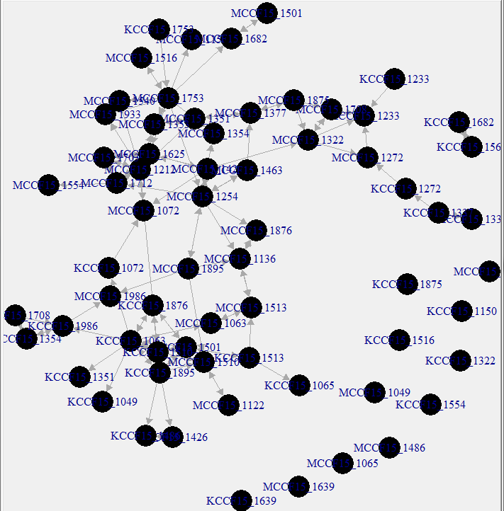
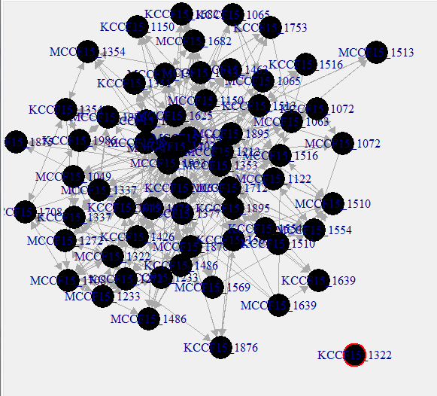
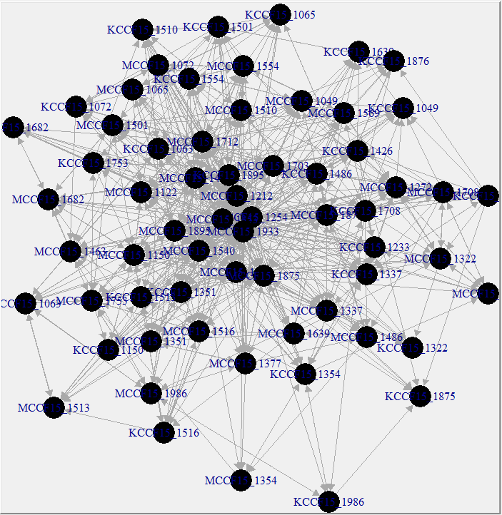
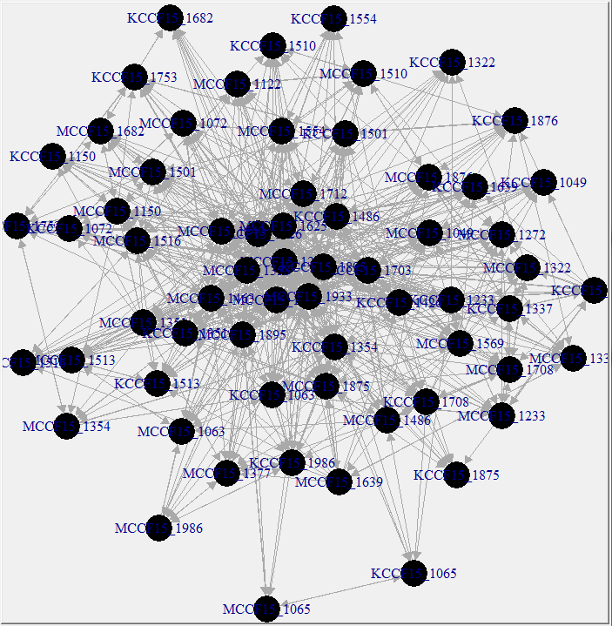
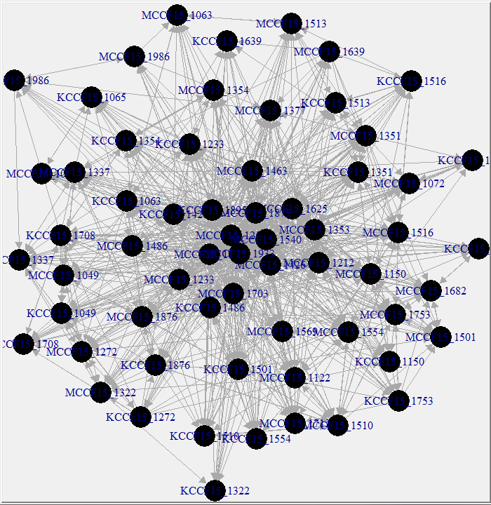
Fall ’15 WEDNESDAY control
Week 1
Week 3
Week 6
Week 9
Den: 0.03
Cen: 0.11
Rec: 0.54
N=66
Den: 0.11
Cen: 0.22
Rec: 0.51
N=64
Den: 0.18
Cen: 0.25
Rec: 0.52
N=64
Den: 0.21
Cen: 0.27
Rec: 0.53
N=63
Checked
Week 11
Den: 0.25
Cen: 0.20
Rec: 0.47
N=63

Slide 6
Spring 16

Slide 7
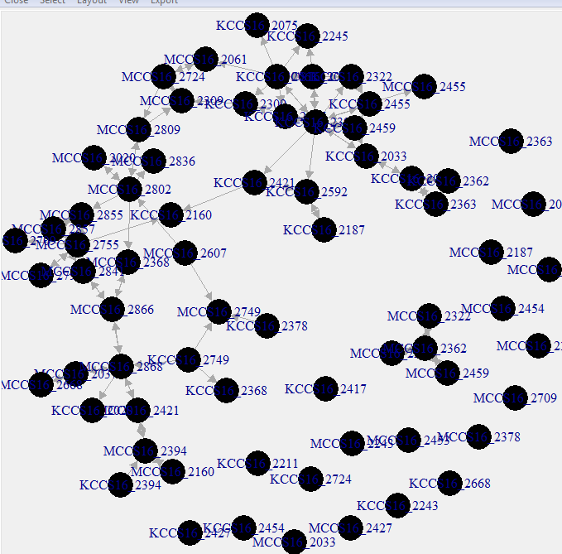
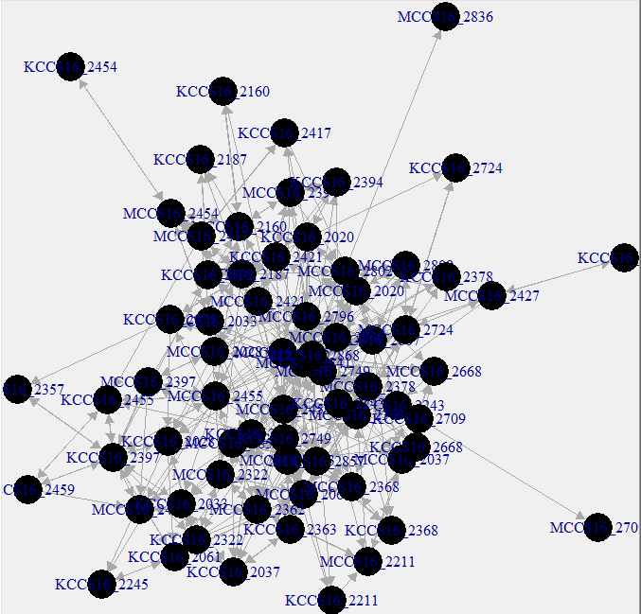
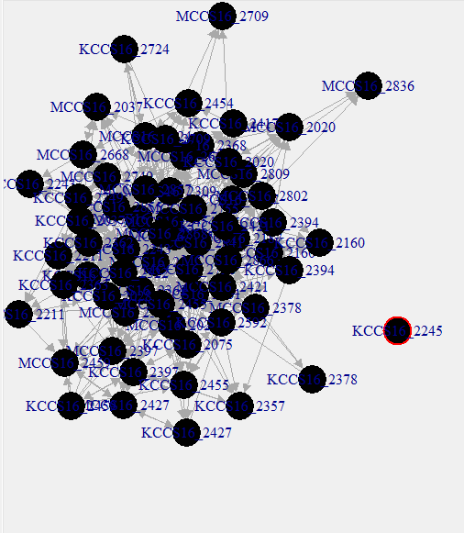
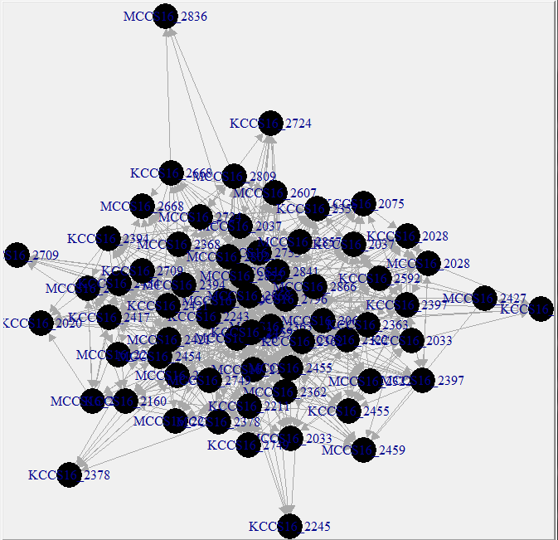
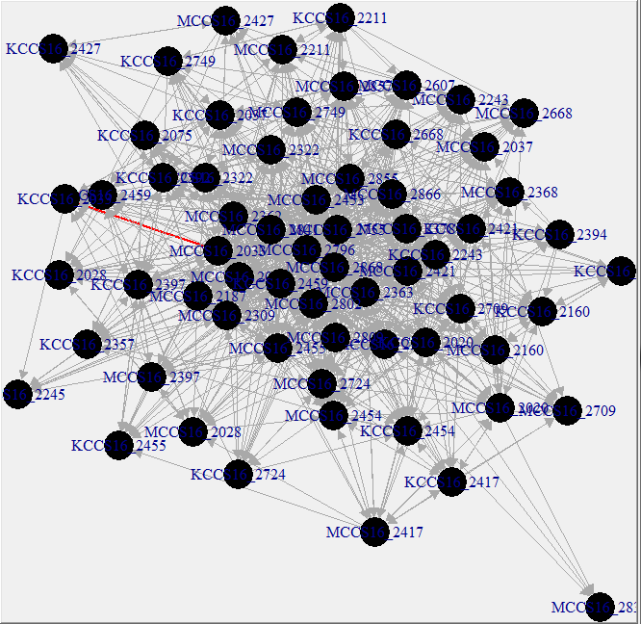
Spring ’16 TUESDAY control
Week 1
Week 3
Week 6
Week 9
Den: 0.02
Cen: 0.07
Rec: 0.65
N=70
Den: 0.08
Cen: 0.23
Rec: 0.52
N=69
Den: 0.15
Cen: 0. 24
Rec: 0.50
N=65
Den: 0.21
Cen: 0.26
Rec: 0. 50
N=66
Week 11
Den: 0.24
Cen: 0.31
Rec: 0.50
N=64

Slide 8
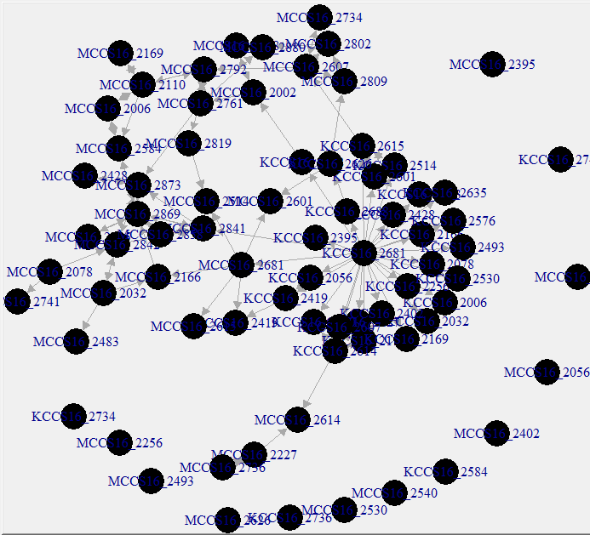
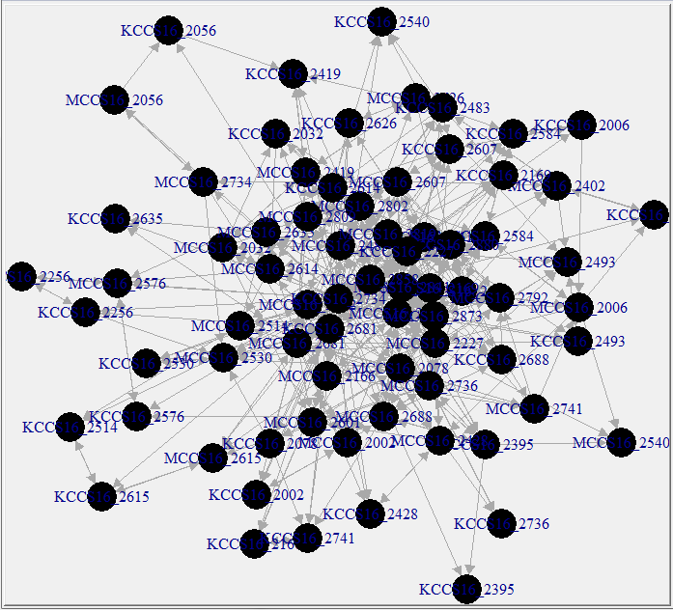
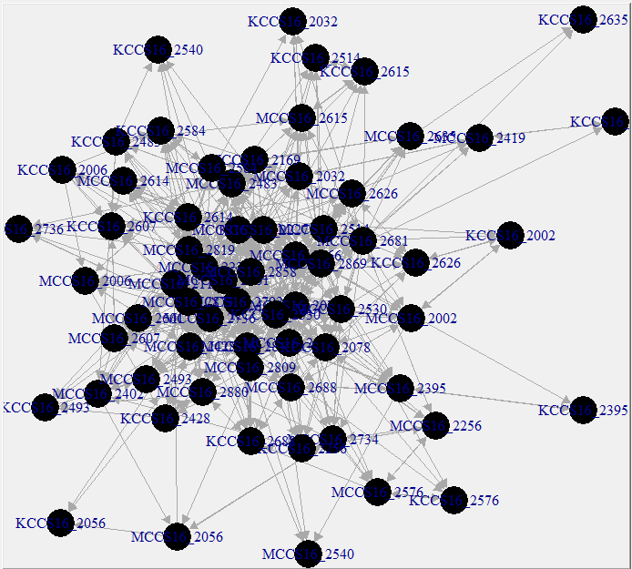
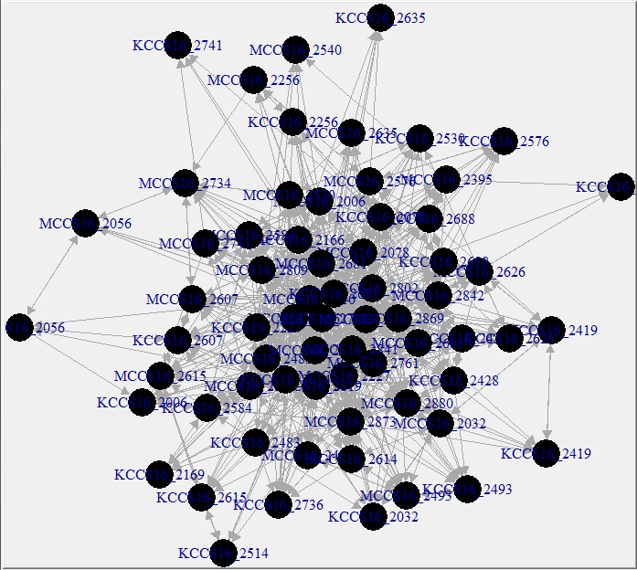
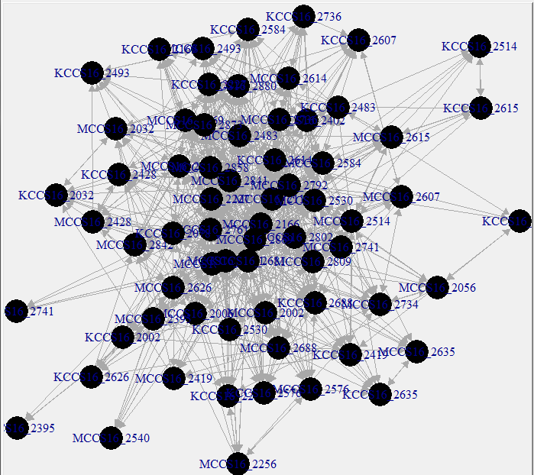
Spring ’16 WEDNESDAY control
Week 1
Week 3
Week 6
Week 9
Den: 0.15
Cen: 0.22
Rec: 0.48
N=66
Den: 0.02
Cen: 0.06
Rec: 0.46
N=75
Den: 0.09
Cen: 0.15
Rec: 0.44
N=73
Den: 0.18
Cen: 0.21
Rec: 0.48
N=67
Week 11
Den: 0.20
Cen: 0.20
Rec: 0.51
N=67

